Slide 1

Object Oriented Analysis and Design with Java
UE20CS352
Prof Nivedita Kasturi
Department of Computer Science and Engineering

Slide 2

UE20CS352: Object Oriented Analysis and Design with Java
OO Design Patterns
Prof Nivedita Kasturi
Department of Computer Science and Engineering

Slide 3
UE20CS352: Object Oriented Analysis and Design with Java
Unit-4
Creational Patterns – Builder

Slide 4
Agenda
Builder-definition
Motivation
Intent
Implementation
Applicability
Structure-Consequence
Issues

Slide 5
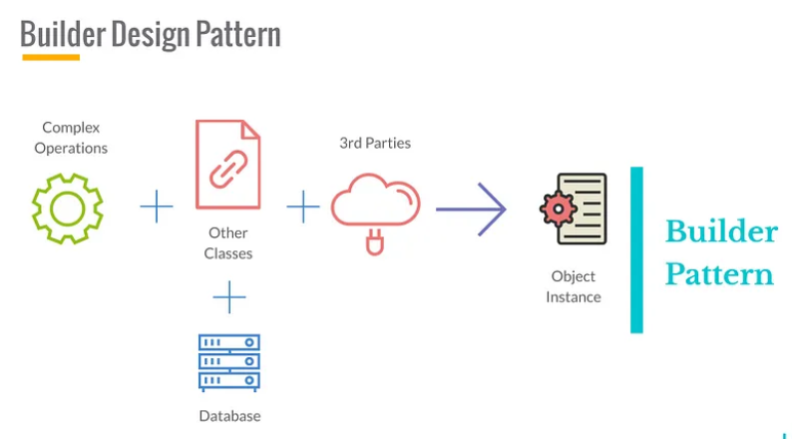
Introduction
Builder Design Pattern as it was intended implies that a sequence of complex operations is needed in order to produce an object instance.
The idea is that we delegate the construction of an object to a specialized class, which is aware of the complex process and logic required to build that specific instance.
This helps us create Single Responsibility classes for complex object creation while at the same time ensuring separation of object creation from business logic.
Based on the nature of the application, Builder implementations might lead to code re-usability, reducing the code base and improving SOLID compliance of our code.

Slide 6
Builder
Definition:
The Builder Design Pattern is another creational pattern designed to deal with the construction of comparatively complex objects.
When the complexity of creating object increases, the Builder pattern can separate out the instantiation process by using another object (a builder) to construct the object.
This builder can then be used to create many other similar representations using a simple step-by-step approach.
Notes:
The builder pattern is a design pattern designed to provide a flexible solution to various object creation problems in object-oriented programming. The intent of the builder design pattern is to separate the construction of a complex object from its representation.

Slide 7
Why Builder Pattern?
The Builder design pattern solves problems like:
How can a class (the same construction process) create different representations of a complex object?
How can a class that includes creating a complex object be simplified?
The Builder design pattern describes how to solve such problems:
Encapsulate creating and assembling the parts of a complex object in a separate Builder object.
A class delegates object creation to a Builder object instead of creating the objects directly.
A class (the same construction process) can delegate to different Builder objects to create different representations of a complex object.
Notes:
Creating and assembling the parts of a complex object directly within a class is inflexible. It commits the class to creating a particular representation of the complex object and makes it impossible to change the representation later independently from (without having to change) the class.

Slide 8
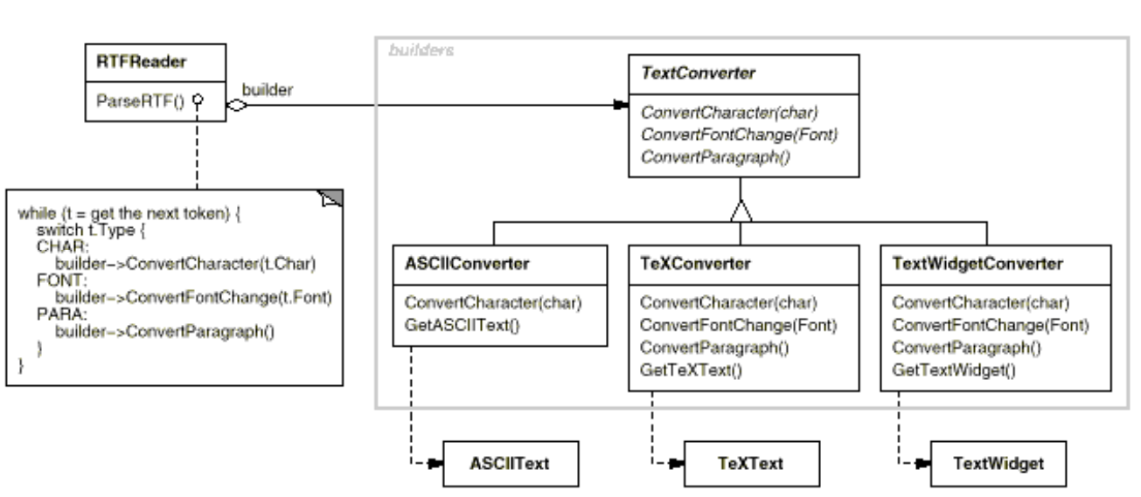
Builder : Class, Object Structural
Motivation
A reader for the RTF (Rich Text Format) document exchange format should be able to convert RTF to many text formats. The reader might convert RTF documents into plain ASCII text or into a text widget that can be edited interactively.
The problem, however, is that the number of possible conversions is open-ended. So it should be easy to add a new conversion without modifying the reader.
A solution is to configure the RTFReader class with a TextConverter object that converts RTF to another textual representation.
The Builder pattern captures all these relationships. Each converter class is called a builder in the pattern, and the reader is called the director.
Notes:
A solution is to configure the RTFReader class with a TextConverter object that converts RTF to another textual representation. As the RTFReader parses the RTF document, it uses the TextConverter to perform the conversion. Whenever the RTFReader recognizes an RTF token (either plain text or an RTF control word), it issues a request to the TextConverter to convert the token.
Applied to this example, the Builder pattern separates the algorithm for interpreting a textual format (that is, the parser for RTF documents) from how a converted format gets created and represented. This lets us reuse the RTFReader's parsing algorithm to create different text representations from RTF documents—just configure the RTFReader with different subclasses of TextConverter.

Slide 9
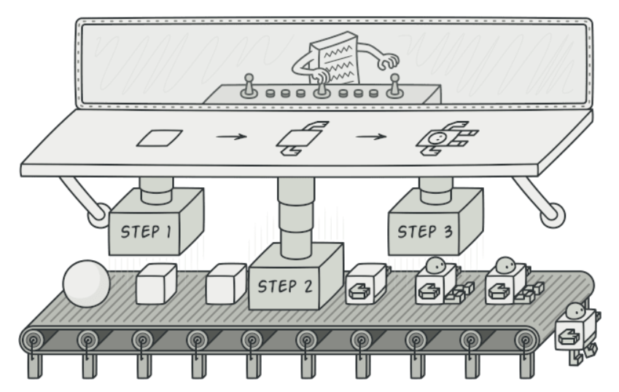

Builder : Class, Object Structural
Intent
Separate the construction of a complex object from its representation so that the same construction process can create different representations
Think of a car factory
Boss tells workers (or robots) to build each part of a car
Workers build each part and add them to the car being constructed

Slide 10
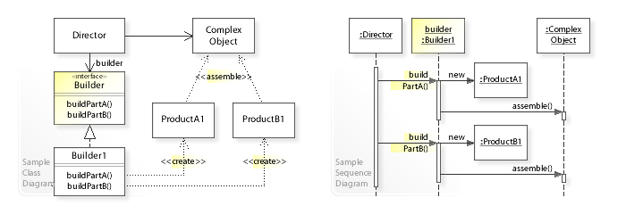
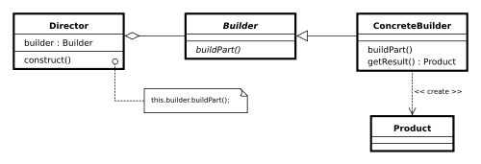
Builder : Implementation
UML class diagram for the Builder Pattern
Builder
Abstract interface for creating objects (product).
ConcreteBuilder
Provides implementation for Builder. It is an object able to construct other objects. Constructs and assembles parts to build the objects.
Class Diagram
Notes:
In the above UML class diagram, the Director class doesn't create and assemble the ProductA1 and ProductB1 objects directly. Instead, the Director refers to the Builder interface for building (creating and assembling) the parts of a complex object, which makes the Director independent of which concrete classes are instantiated (which representation is created). The Builder1 class implements the Builder interface by creating and assembling the ProductA1 and ProductB1 objects. The UML sequence diagram shows the run-time interactions: The Director object calls buildPartA() on the Builder1 object, which creates and assembles the ProductA1 object. Thereafter, the Director calls buildPartB() on Builder1, which creates and assembles the ProductB1 object.

Slide 11
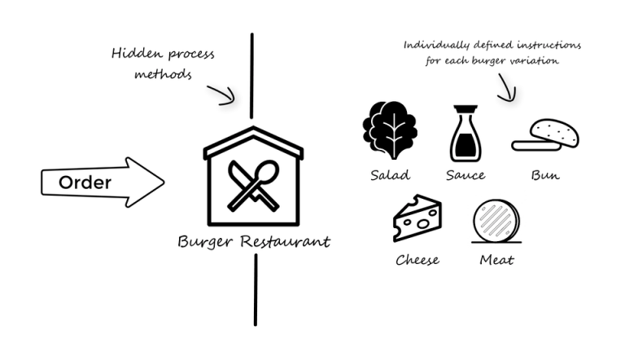
Builder : Implementation example-1
Problem Statement: Case study
We will set the objective of making a burger restaurant, which can make different variations of burgers.
Secondly it would also be preferable to have defined instructions for how to build each of the different variations of burgers (e.g. cheeseburger), so that we do not have to provide all the ingredients each time when we are making a burger.
Before, how the builder design pattern will be able to solve these issues, we will start by seeing how this system could be build based on construction of the burger object in the main context.
Notes:
The only thing we know is that all burgers share the same structure and contain the same five basic elements in some form. The five elements being: bun, meat, salad, cheese and sauce.
However, each of the elements should be seen as a complex process (e.g. making the secret sauce) and it would therefore be desirable to have these processes hidden away when making different variations of burgers.

Slide 12
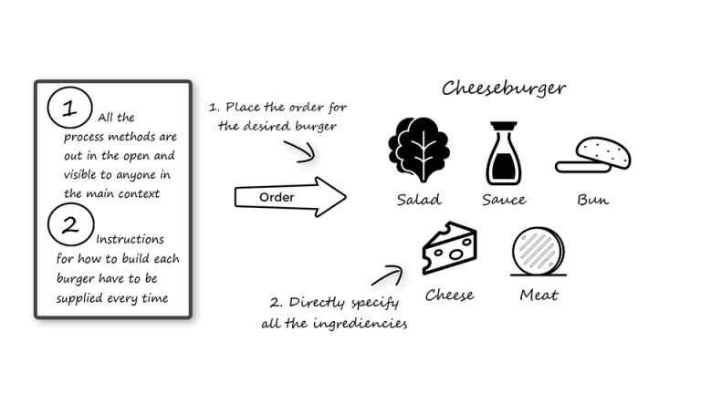
Builder : Implementation example-1
Solution: Construction In The Main Context
public class Main {
public static void main(String[] args) {
Burger cheeseBurger = new Burger();
cheeseBurger.setBun("White Bread");
cheeseBurger.setSalad("Iceberg");
cheeseBurger.setCheese("American Chesse");
cheeseBurger.setSauce("Secret Sauce");
cheeseBurger.print();
}
Notes:
The basic problem that we want to solve is to have a way of making burger objects with the possibility of making different variations in each of the five elements which all burgers consist of.
The simplest way of achieving this is to create a POJO (Plain Old Java Object – Link), which represent the basic functions and fields of a burger object.
This solves the basic objective of being able to create any variation of burgers on the menu card (e.g. cheeseburger), but it does not hide the processes away or define instructions for how to repeatably build the same burger object simply.
Constructing the burger object in the main context, as can be seen below, is neither the builder pattern nor clean code.
Let’s try and see how the builder pattern can solve the same objective, and at the same time handle the additional objectives.

Slide 13
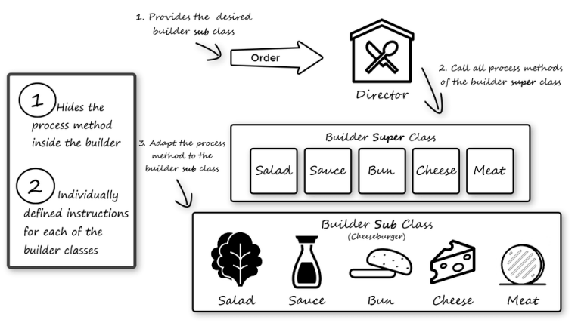
Solution: Concept Of The Builder Pattern
When talking about the builder design pattern, it is important to understand the concept of the Director and the Builder.
The director’s job is to invoke the building process of the builder. The builder’s job is to manage the different building procedures associated with each of the different variations of objects, in this case the burgers.
The builder pattern consists of two classes, a sub- and super class.
Notes:
When talking about the builder design pattern, it is important to understand the concept of the Director and the Builder.
The director’s job is to invoke the building process of the builder. The builder’s job is to manage the different building procedures associated with each of the different variations of objects, in this case the burgers.
The builder pattern consists of two classes, a sub- and super class.
The super class is an abstract class which only declares the concrete methods and fields which all sub class have in common. In this case that would be the print method and the burger object field. Additionally, the super class also states the expected process methods that any builder sub class should implement.
The sub class, then implements the declared process methods, and uses the super classes’ burger object field to set the five different elements to what is expected from that specific sub class builder.
Continuing this pattern makes it possible to create multiple different builder classes, which all know exactly how to build their specific variation of burger, meanwhile still following the common rules of the builder super class.
By invoking the builder through the director, it is thereby possible to swap between builder instances, which is what makes the builder pattern both flexible and practical.
Utilizing the builder design pattern solves the main objective as well as hide the process method and clearly defines how each of the burger builders should work.That all sounds great! So, let’s dive into the class diagram and code to see how we actually implement the builder pattern.

Slide 14
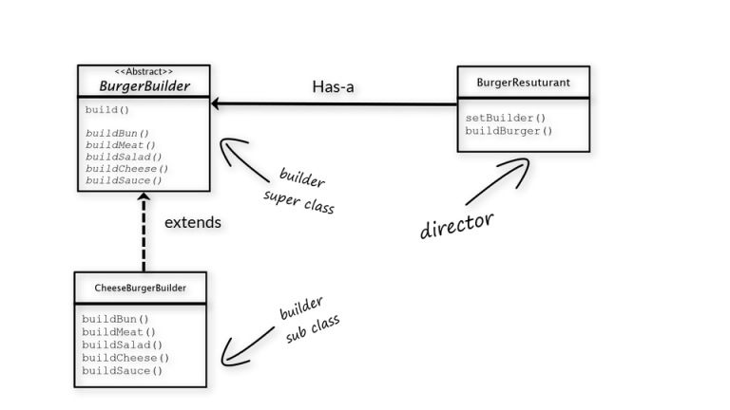
Design Solution :Class Diagram (UML)
Builder pattern consists of two main class types: the builder and the director
With the context of program we will be using the builder pattern, it means we actually only want to be interacting with the director.
The director will ensure that we build the correct burger object based on which builder we provide it with.
Inside the director, we set its builder object field (setBuilder-method) and afterwards ask it to build the object based on the provided builder (build-method).
Notes:
As we learn from the previous section the builder pattern consists of two main class types: the builder and the director. Seen from the context of the program which will be using the builder pattern, we actually only want to be interacting with the director.
The director will ensure that we build the correct burger object based on which builder we provide it with. This is because inside the director, we set its builder object field (setBuilder-method) and afterwards ask it to build the object based on the provided builder (build-method).
As previously explain the different builder class all have different variations in terms of the five elements which a burger consists of. But when it comes to everything else, they are all alike since they extend the same super class.

Slide 15
Solution : Java Code
Link to java implementation
Note: Java files in the src/builderPatternDemo (it’s a eclipse source file)
Notes:
As we learn from the previous section the builder pattern consists of two main class types: the builder and the director. Seen from the context of the program which will be using the builder pattern, we actually only want to be interacting with the director.
The director will ensure that we build the correct burger object based on which builder we provide it with. This is because inside the director, we set its builder object field (setBuilder-method) and afterwards ask it to build the object based on the provided builder (build-method).
As previously explain the different builder class all have different variations in terms of the five elements which a burger consists of. But when it comes to everything else, they are all alike since they extend the same super class.

Slide 16
Builder : Scenario example-2
Problem
An application needs to create the elements of a complex aggregate. The specification for the aggregate exists on secondary storage and one of many representations needs to be built in primary storage.
Discussion
Separate the algorithm for interpreting (i.e. reading and parsing) a stored persistence mechanism (e.g. RTF files) from the algorithm for building and representing one of many target products (e.g. ASCII, TeX, text widget). The focus/distinction is on creating complex aggregates.
The "director" invokes "builder" services as it interprets the external format. The "builder" creates part of the complex object each time it is called and maintains all intermediate state. When the product is finished, the client retrieves the result from the "builder".
Affords finer control over the construction process. Unlike creational patterns that construct products in one shot, the Builder pattern constructs the product step by step under the control of the "director".

Slide 17
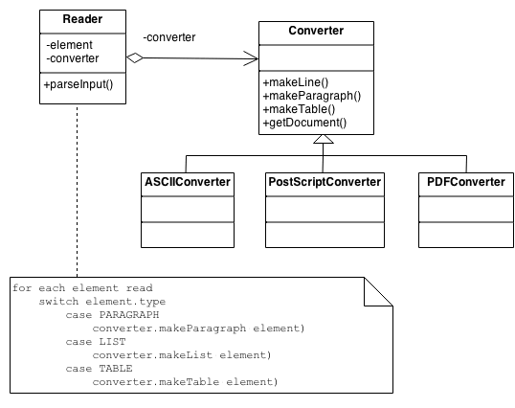
Builder Scenario example-2 : Design Solution
The Reader encapsulates the parsing of the common input. The Builder hierarchy makes possible the polymorphic creation of many peculiar representations or targets.

Slide 18
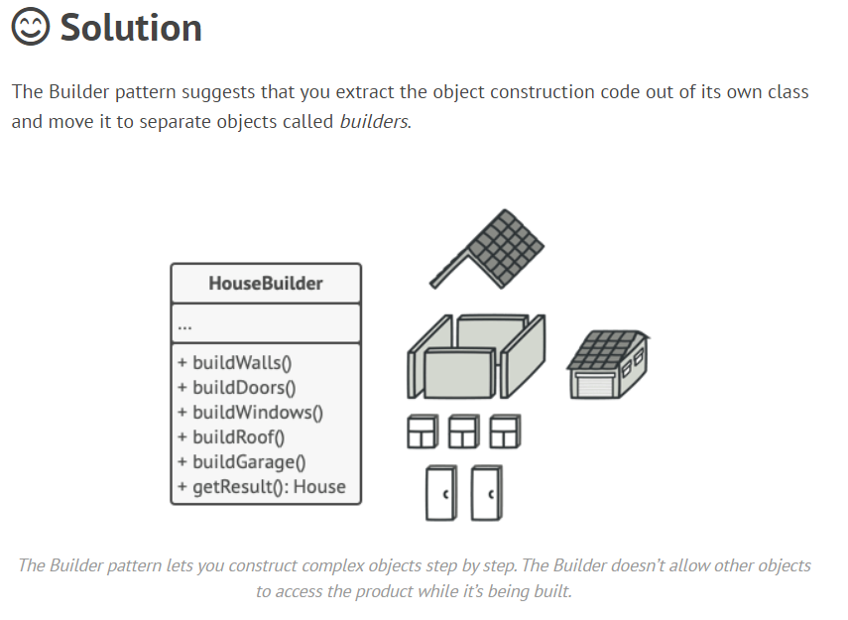
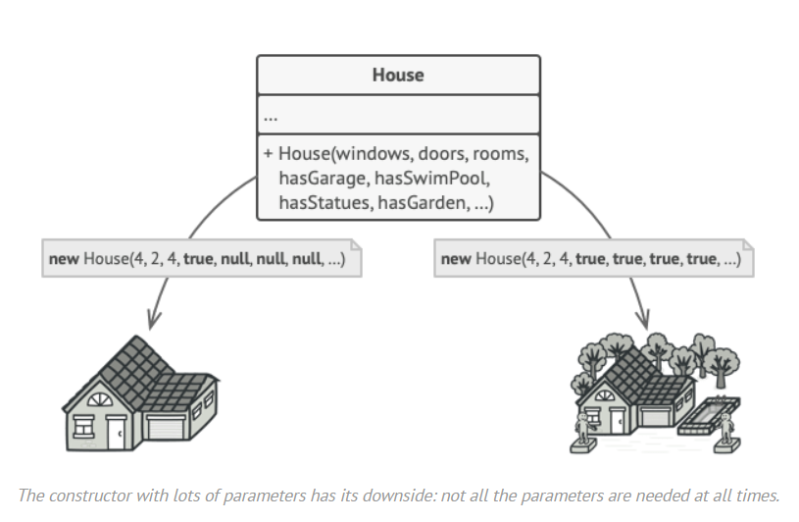
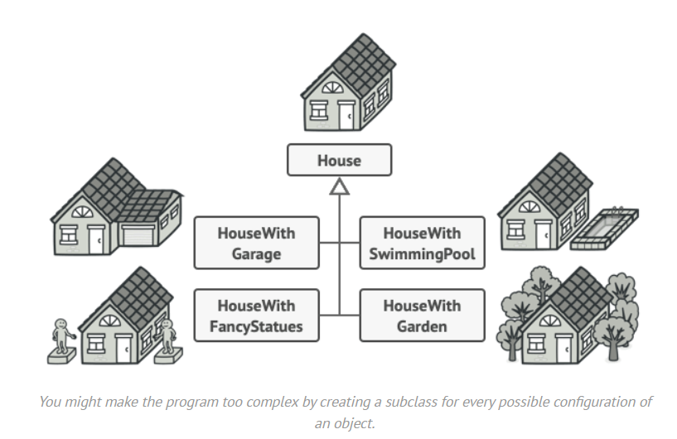
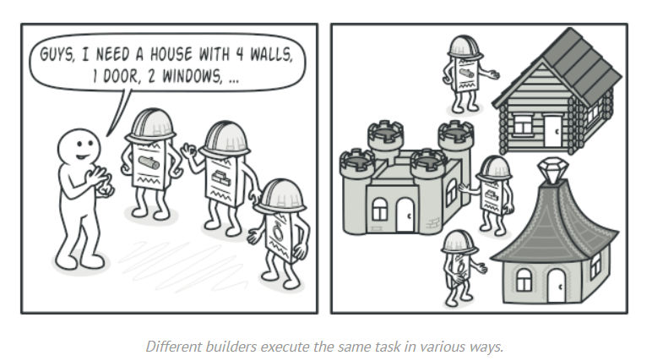
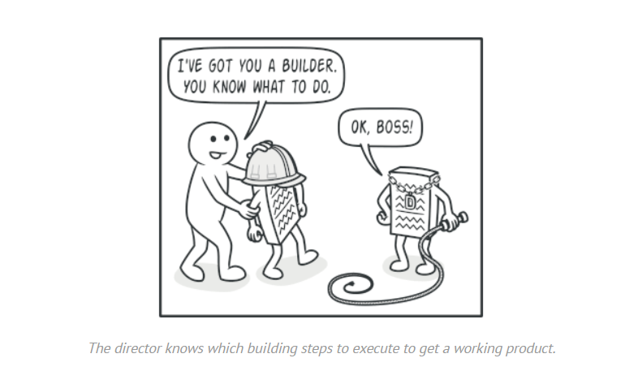
Builder : Scenario example-3
For example, let’s think about how to create a House object.
To build a simple house, you need to construct four walls and a floor, install a door, fit a pair of windows, and build a roof. But what if you want a bigger, brighter house, with a backyard and other goodies (like a heating system, plumbing, and electrical wiring)?
Link to scenario example-3 document

Slide 19
Applicability
Use the Builder pattern when
The algorithm for creating a complex object should be independent of the parts that make up the object and how they're assembled.
The construction process must allow different representations for the object that's constructed.
You want to get rid of a “telescoping constructor”. Say you have a constructor with ten optional parameters. Calling such a beast is very inconvenient; therefore, you overload the constructor and create several shorter versions with fewer parameters.
You want your code to be able to create different representations of some product (for example, stone and wooden houses). The Builder pattern can be applied when construction of various representations of the product involves similar steps that differ only in the details.
Notes:
Use the Builder pato get rid of a “telescoping constructor”.
Say you have a constructor with ten optional parameters. Calling such a beast is very inconvenient; therefore, you overload the constructor and create several shorter versions with fewer parameters. These constructors still refer to the main one, passing some default values into any omitted parameters.
class Pizza { Pizza(int size) { ... } Pizza(int size, boolean cheese) { ... } Pizza(int size, boolean cheese, boolean pepperoni) { ... } // ... Creating such a monster is only possible in languages that support method overloading, such as C# or Java.
The Builder pattern lets you build objects step by step, using only those steps that you really need. After implementing the pattern, you don’t have to cram dozens of parameters into your constructors anymore.
Use the Builder pattern when you want your code to be able to create different representations of some product (for example, stone and wooden houses).
The Builder pattern can be applied when construction of various representations of the product involves similar steps that differ only in the details.
The base builder interface defines all possible construction steps, and concrete builders implement these steps to construct particular representations of the product. Meanwhile, the director class guides the order of construction.
Use the Builder to construct Composite trees or other complex objects.
The Builder pattern lets you construct products step-by-step. You could defer execution of some steps without breaking the final product. You can even call steps recursively, which comes in handy when you need to build an object tree.
A builder doesn’t expose tern tthe unfinished product while running construction steps. This prevents the client code from fetching an incomplete result.

Slide 20
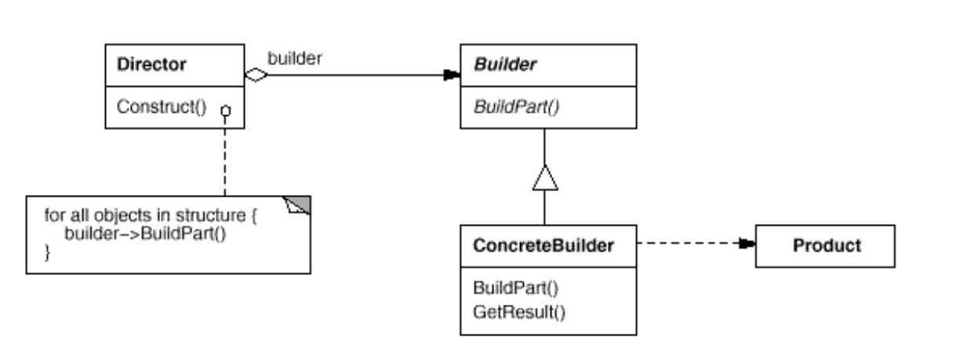
Structure

Slide 21
Participants
Builder (TextConverter)
o specifies an abstract interface for creating parts of a Product object.
ConcreteBuilder (ASCIIConverter, TeXConverter, TextWidgetConverter)
o constructs and assembles parts of the product by implementing the Builder interface.
o defines and keeps track of the representation it creates.
o provides an interface for retrieving the product (e.g., GetASCIIText, GetTextWidget). ·
Director (RTFReader)
o constructs an object using the Builder interface.
Product (ASCIIText, TeXText, TextWidget)
o represents the complex object under construction. ConcreteBuilder builds the product's internal representation and defines the process by which it's assembled.
o includes classes that define the constituent parts, including interfaces for assembling the parts into the final result.
Notes:
Builder Specifies an abstract interface for creating parts of a Product object
ConcreteBuilder
Constructs and assembles parts of the product by implementing the Builder interface
Director
Constructs an object using the Builder interface
Product
Represents the complex object under construction Includes classes that define the constituent parts Gives interfaces for assem- bling the parts

Slide 22
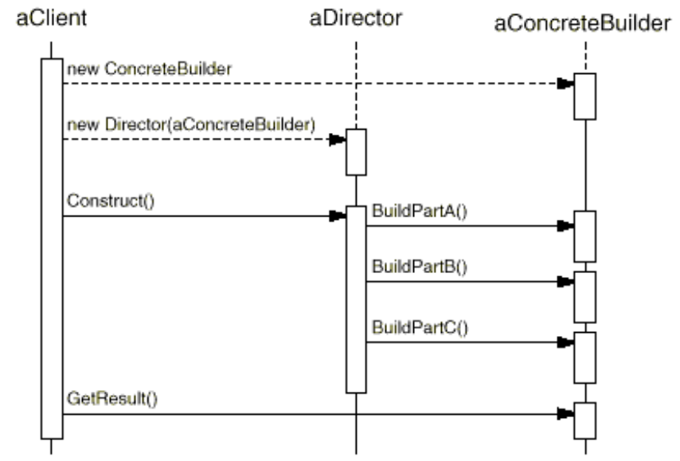
Collaboration
Client creates Director object and configures it with a Builder
Director notifies Builder to build each part of the product
Builder handles requests from Director and adds parts to the product
Client retrieves product from the Builder
The following interaction diagram illustrates how Builder and Director cooperate with a client.

Slide 23
Consequence
Lets you vary a product’s internal representation by using different Builders
Isolates code for construction and representation
Gives finer-grain control over the construction process

Slide 24
Issues to consider when using the Builder pattern
Assembly and construction interface: generality
Is an abstract class for all Products necessary?
Usually products don’t have a common interface
Usually there’s an abstract Builder class that defines an operation for each component that a director may ask it to create.
These operations do nothing by default (empty, static methods )
The ConcreteBuilder overrides operations selectively
Notes:
Non- virtual member functions are resolved statically. That is, the member function is selected statically (at compile-time) based on the type of the pointer (or reference) to the object. In contrast, virtual member functions are resolved dynamically (at run-time).

Slide 25
How to Implement
Make sure that you can clearly define the common construction steps for building all available product representations.
Declare these steps in the base builder interface.
Create a concrete builder class for each of the product representations and implement their construction steps.
Think about creating a director class. It may encapsulate various ways to construct a product using the same builder object.
The client code creates both the builder and the director objects. Before construction starts, the client must pass a builder object to the director.
The construction result can be obtained directly from the director only if all products follow the same interface. Otherwise, the client should fetch the result from the builder.
Notes:
Make sure that you can clearly define the common construction steps for building all available product representations. Otherwise, you won’t be able to proceed with implementing the pattern.
Declare these steps in the base builder interface.
Create a concrete builder class for each of the product representations and implement their construction steps.
Don’t forget about implementing a method for fetching the result of the construction. The reason why this method can’t be declared inside the builder interface is that various builders may construct products that don’t have a common interface. Therefore, you don’t know what would be the return type for such a method. However, if you’re dealing with products from a single hierarchy, the fetching method can be safely added to the base interface.
Think about creating a director class. It may encapsulate various ways to construct a product using the same builder object.
The client code creates both the builder and the director objects. Before construction starts, the client must pass a builder object to the director. Usually, the client does this only once, via parameters of the director’s class constructor. The director uses the builder object in all further construction. There’s an alternative approach, where the builder is passed to a specific product construction method of the director.
The construction result can be obtained directly from the director only if all products follow the same interface. Otherwise, the client should fetch the result from the builder.

Slide 26
Pro and Cons
Pros
You can construct objects step-by-step, defer construction steps or run steps recursively.
You can reuse the same construction code when building various representations of products.
Single Responsibility Principle. You can isolate complex construction code from the business logic of the product.
Cons
The overall complexity of the code increases since the pattern requires creating multiple new classes.

Slide 27
Relations with Other Patterns
Many designs start by using Factory Method (less complicated and more customizable via subclasses) and evolve toward Abstract Factory, Prototype, or Builder (more flexible, but more complicated).
Builder focuses on constructing complex objects step by step. Abstract Factory specializes in creating families of related objects. Abstract Factory returns the product immediately, whereas Builder lets you run some additional construction steps before fetching the product.
You can use Builder when creating complex Composite trees because you can program its construction steps to work recursively.
You can combine Builder with Bridge: the director class plays the role of the abstraction, while different builders act as implementations.
Abstract Factories, Builders and Prototypes can all be implemented as Singletons.

Slide 28
Demo
Link for builder demo

Slide 29
References
Text Reference
Design Patterns: Elements of Reusable Object-Oriented Software, GOF
Web Reference
https://www.baeldung.com/creational-design-patterns
https://www.javatpoint.com/builder-design-pattern
https://sourcemaking.com/design_patterns/builder
https://integu.net/builder-pattern/
https://www.c-sharpcorner.com/article/builder-design-pattern-with-java/

Slide 30
THANK YOU
Prof Nivedita Kasturi
Department of Computer Science and Engineering
niveditak@pes.edu

